Slide 1







HIGH CLOUD AIRLINE
PRESENTED BY: GROUP-4

Slide 2

Contents

Slide 3



Contents
Introduction
ELT Process/Relations
Dashboards
Insights (Problems)
Suggestions/Recommendation (Solutions)

Slide 4

INTRODUCTION

Slide 5



To Revolutionize the Airline Industry through the Data-Driven Insights and Optimizations.

Slide 6

Elt/PROCESS RELATIONS

Slide 7


Elt/PROCESS RELATIONS
ELT (Extract, Load, Transform) is a modern data processing approach where data is first extracted from various sources, loaded into a data warehouse, and then transformed into a usable format for analysis. This method allows for greater flexibility, scalability, and efficiency in handling large volumes of data, making it ideal for businesses seeking to leverage data-driven insights.
Extraction: Gather data from multiple sources.
Loading: Store raw data in a centralized data warehouse.
Transformation: Convert data into a format ready for analysis.

Slide 8

DASHBOARDS

Slide 9
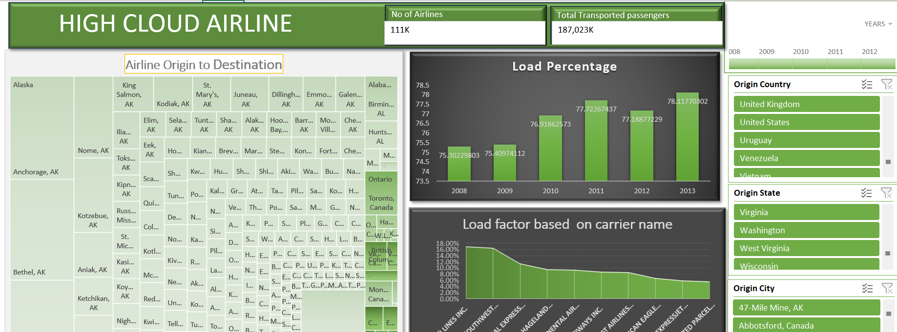

Slide 10
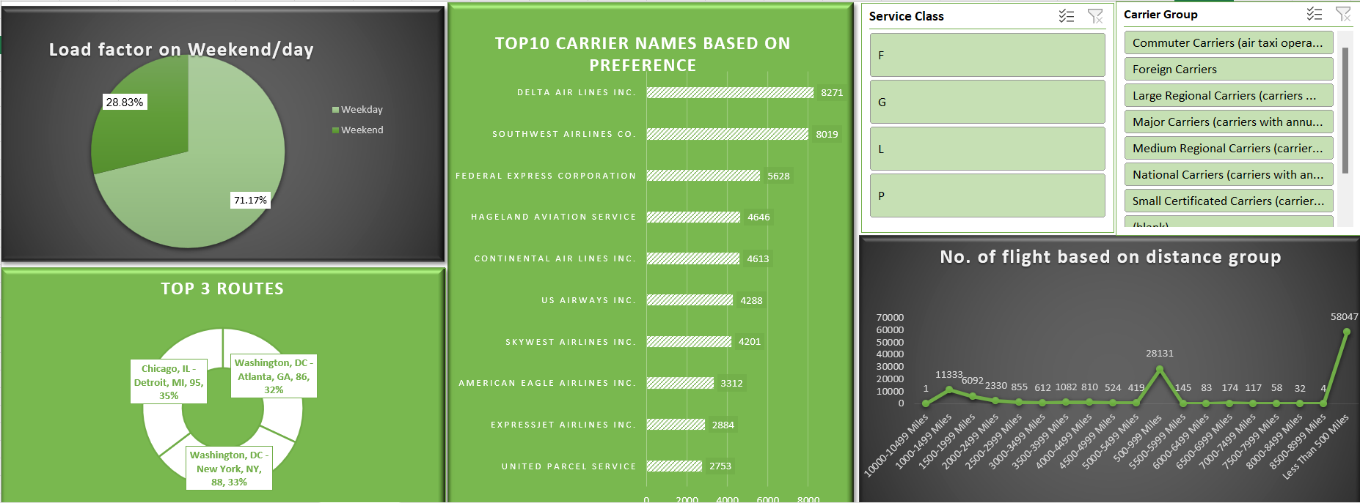

Slide 11
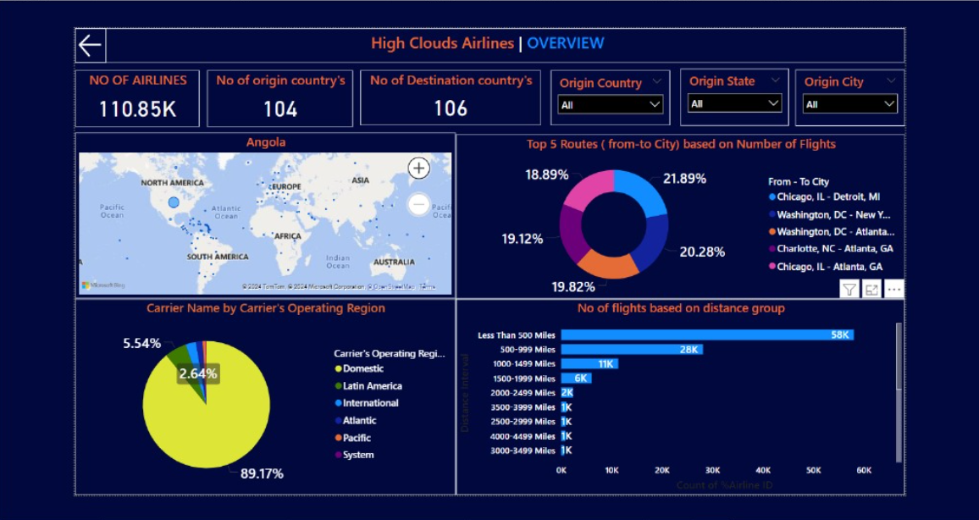

Slide 12
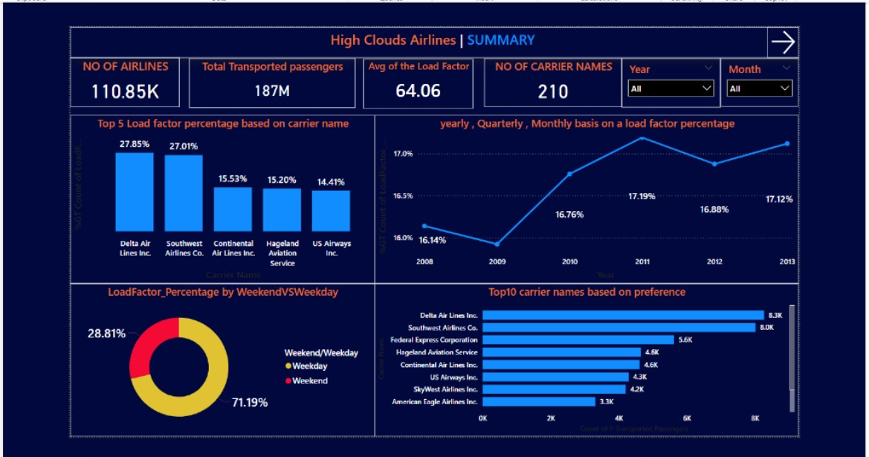

Slide 13
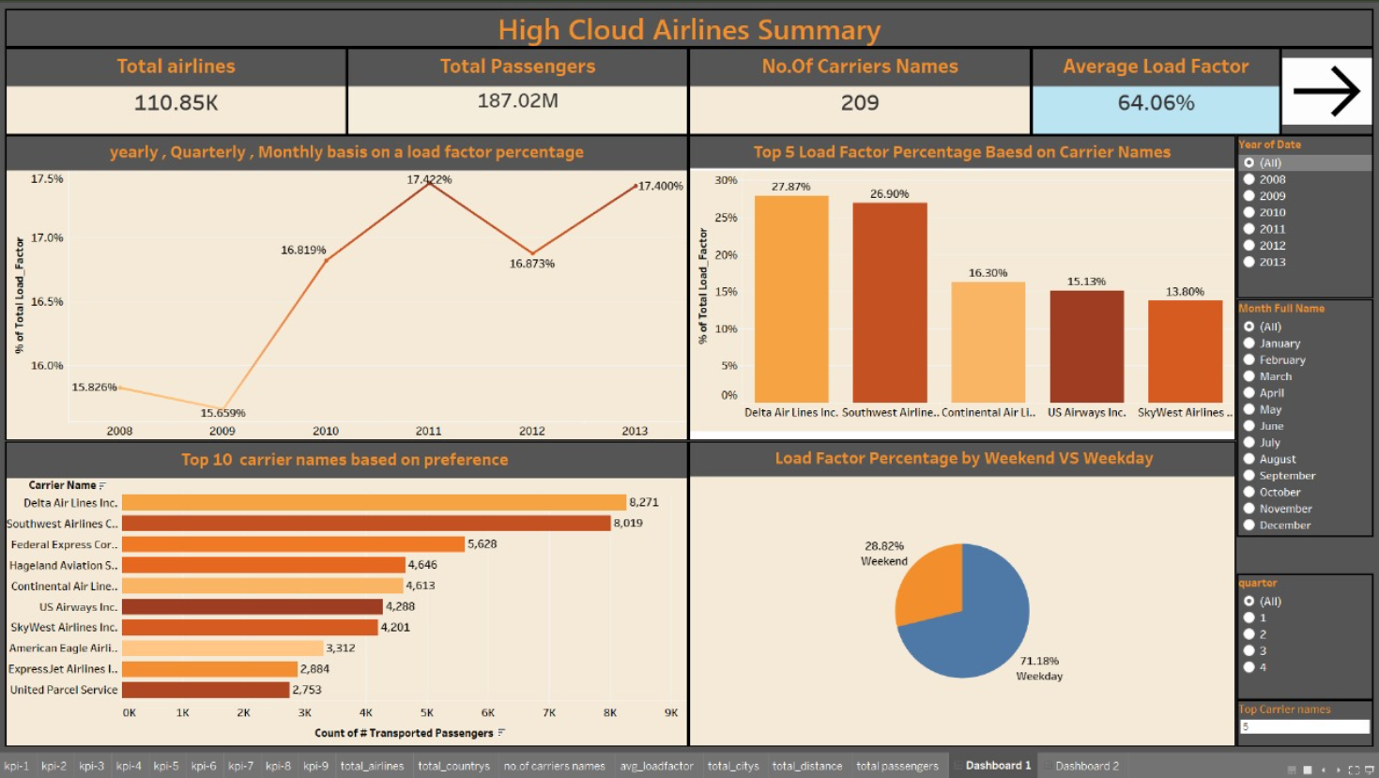

Slide 14
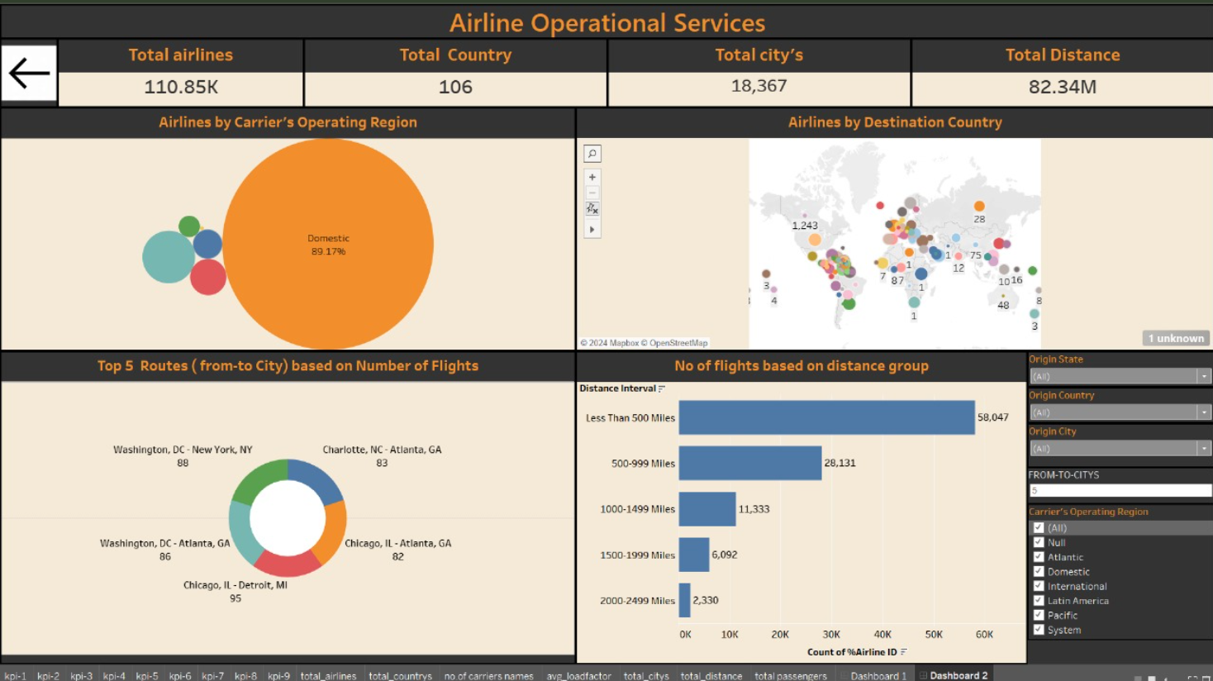

Slide 15

INSIGHTS

Slide 16



INSIGHTS
The current data handling methods lack the agility and scalability needed to manage large volumes of data effectively, resulting in missed opportunities for personalized customer experiences and operational improvements.
> We found detailed insights about the carrier's operating regions, with the domestic region leading at 89.17% and the Pacific region having the lowest share at 0.91%
> We analyzed origin market cities, finding New York, NY, leading with 4,450 departures, while 101 cities had only one.
> The insights show that there are 8,352 Canadair RJ-200 ER flights, approximately 4,055 Boeing 757-200 flights, and only one Aero Commander flight, representing the number of aircraft types

Slide 17

SUGGESTION/
RECOMMENDATION

Slide 18


SUGGESTION/RECOMMENDATION
>To address the challenges faced by High Cloud Airlines, it is recommended to implement a robust ELT (Extract, Load, Transform) framework. By transforming data post-loading, the airline can quickly adapt to increasing data volumes and complexity, ensuring that insights are both timely and actionable.
>We found the load factor to be 71.19% on weekdays and 28.81% on weekends, suggesting increased airlines during weekends.
>We found that approximately three airlines operate flights to Kuwait, and we suggest increasing the number of airlines serving this country to enhance connectivity and improve travel options.

Slide 19
Revathi
Vaishanvi
Vikas
Shiva
Sagar
Nagendra
Thank you

